Slide 1


AAPI HERITAGE MONTH DIALOGUE

Slide 2
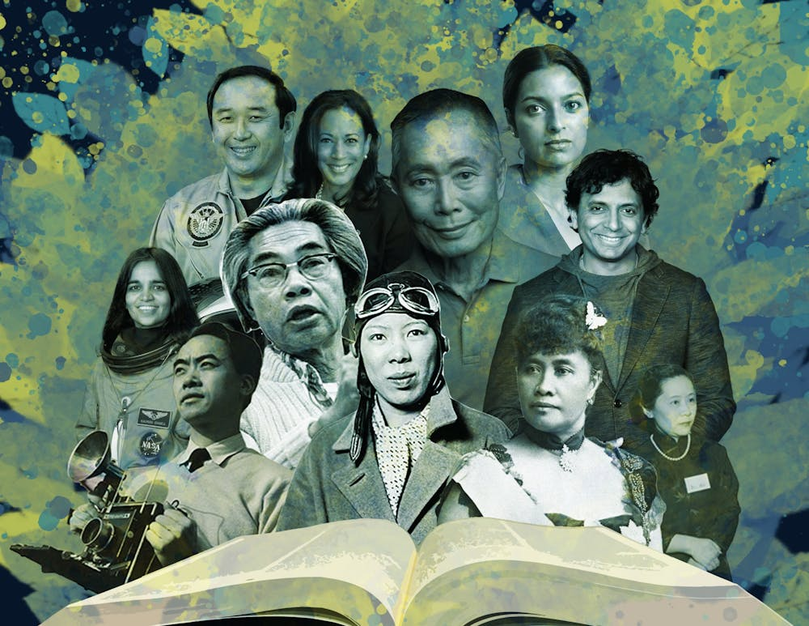
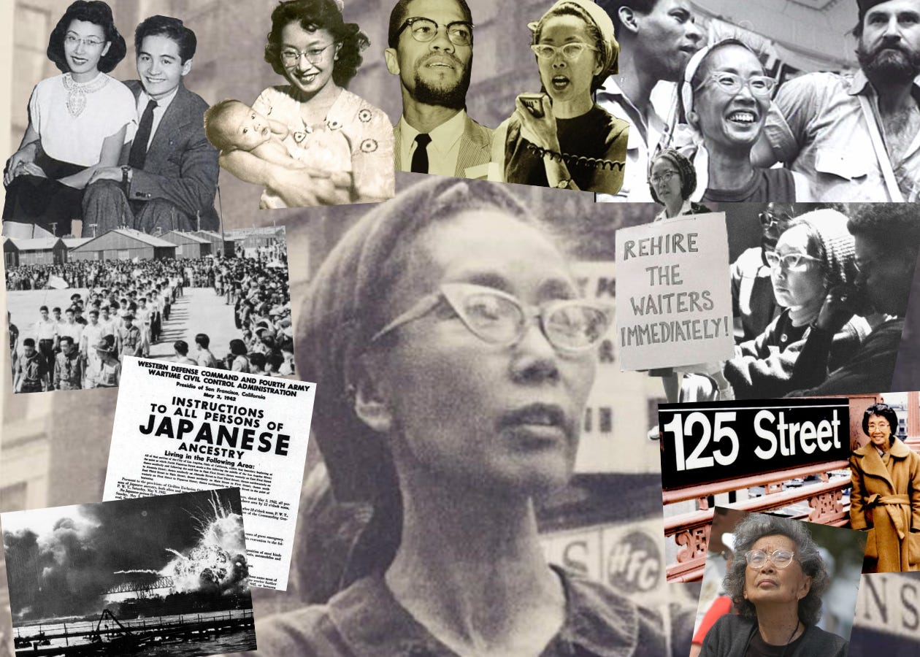
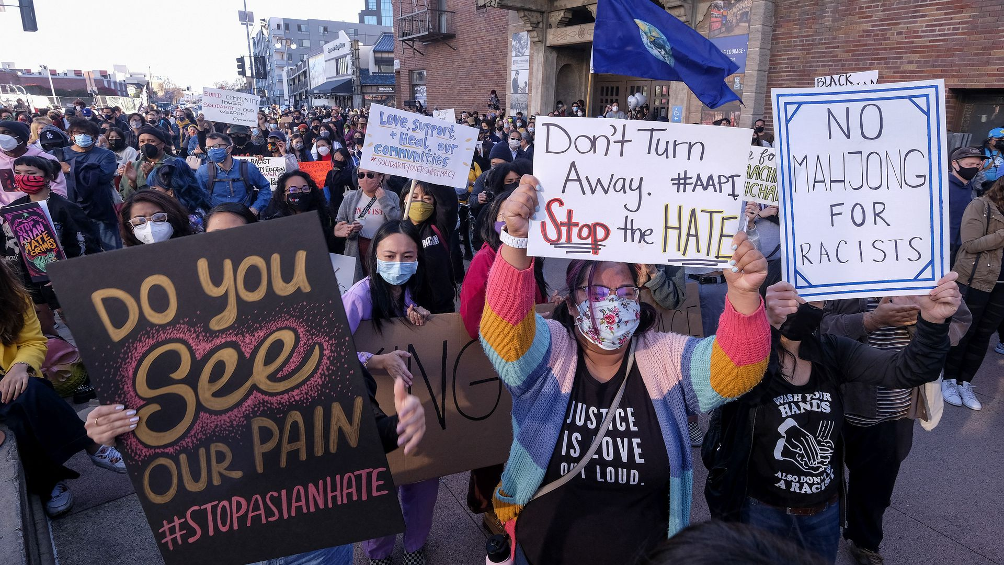
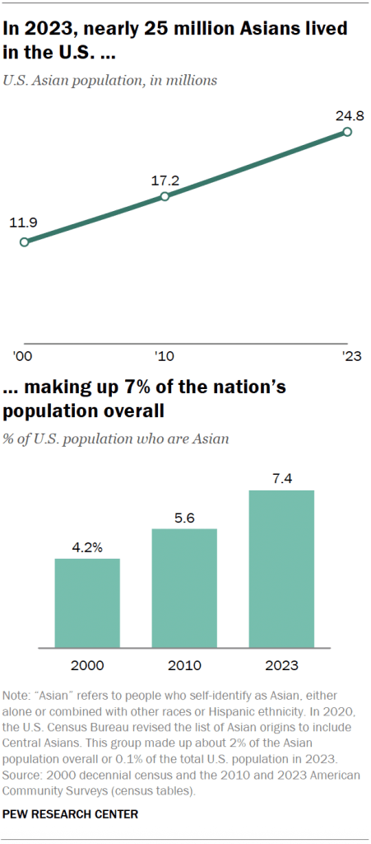
WHAT IS AAPI HERITAGE MONTH
Honors the contributions, histories, and cultures of Asian American, Native Hawaiian, and Pacific Islander communities
May was chosen to commemorate various accomplishments and milestones such as the arrival of the first Japanese immigrants, and the completion of the transcontinental railroad
First recognized as Asian Pacific American Heritage Week in 1979 (President Jimmy Carter). Expanded to a full month in 1990 (President George H.W. Bush). Renamed Asian American and Pacific Islander Heritage Month in 2009 by President Barack Obama
25.8 million Asian Americans living in the US, making up 7.7% of the population

Slide 3
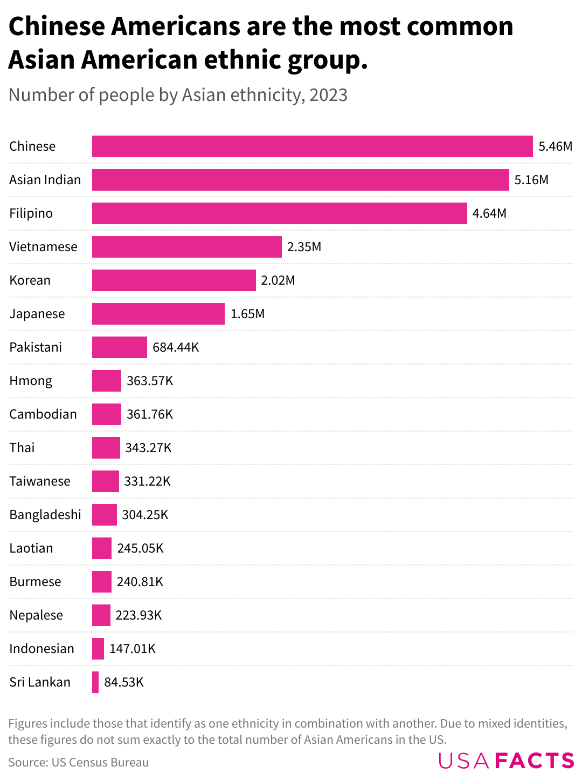
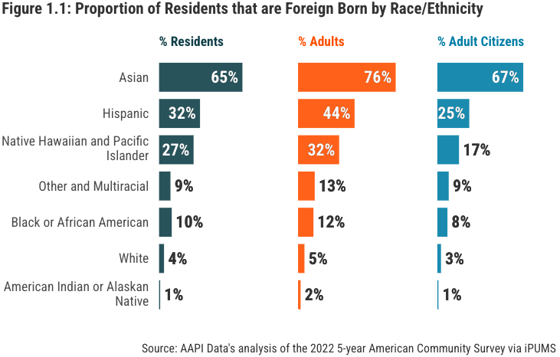
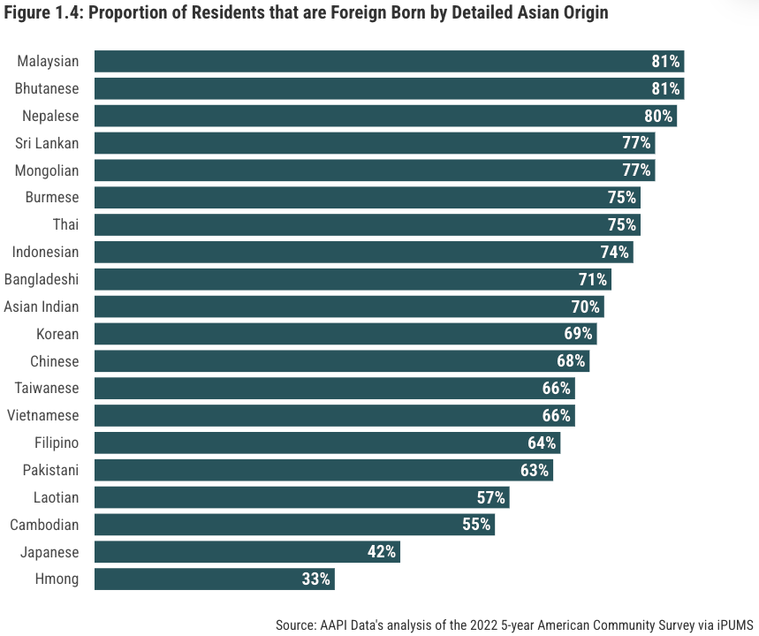
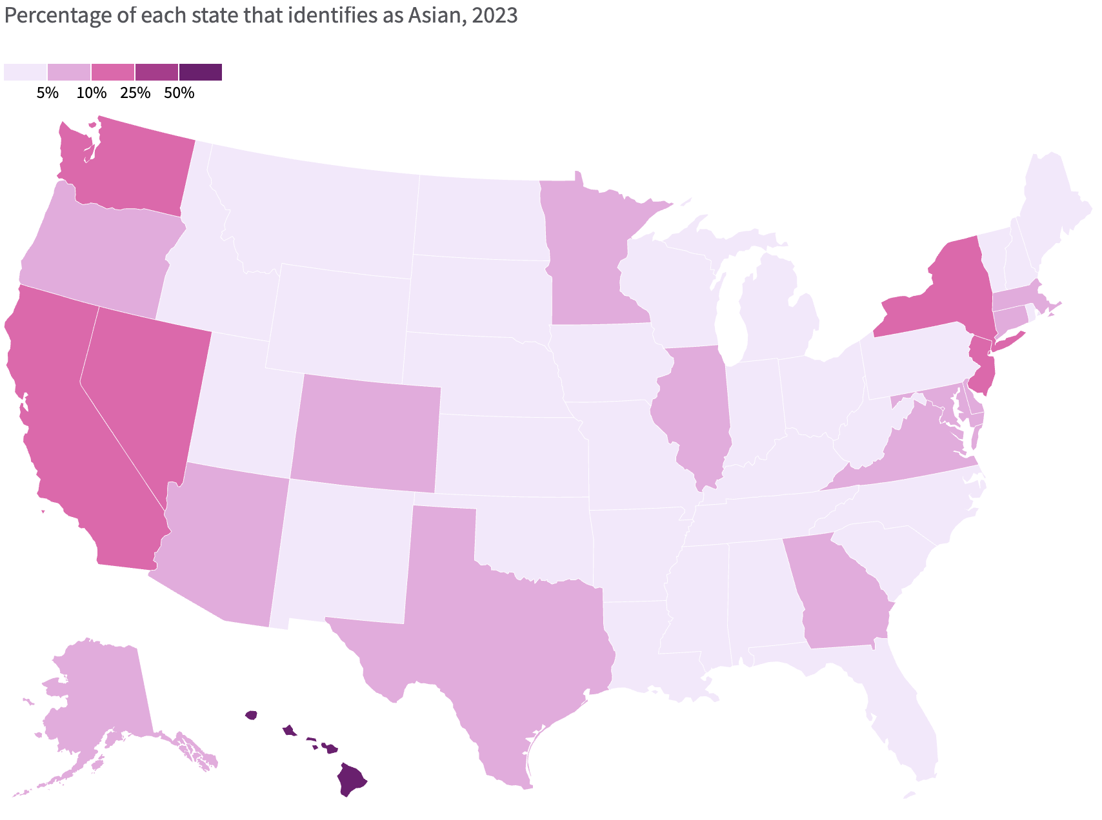
DIFFERENT JOURNEYS SHARED SPACE
There is no single AAPI experience
AAPI communities consist of approximately 50 ethnic groups speaking over 100 languages, with connections to Chinese, Indian, Japanese, Filipino, Vietnamese, Korean, Hawaiian, and other Asian and Pacific Islander ancestries.
Dialogue helps us honor that complexity

Slide 4
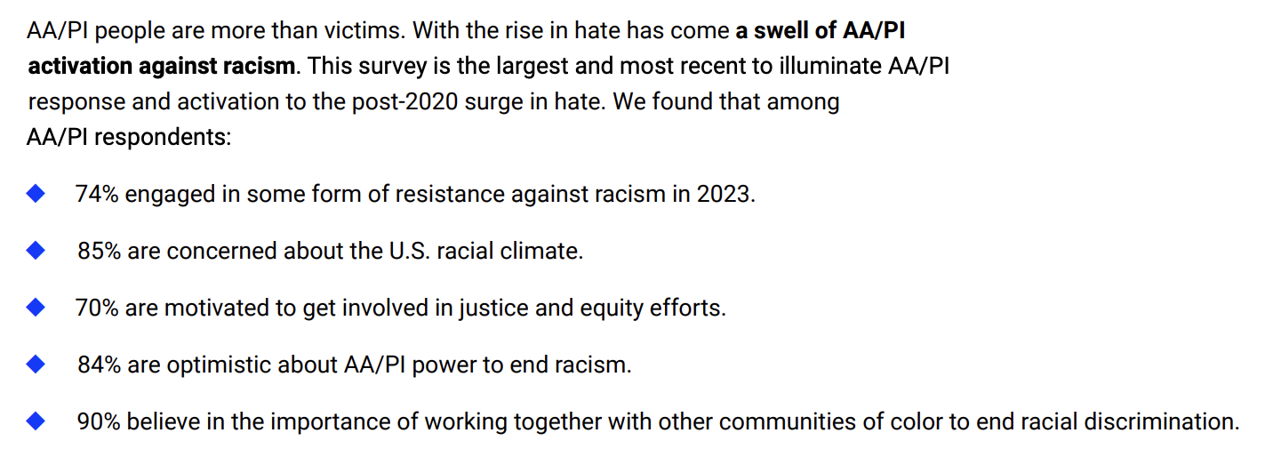

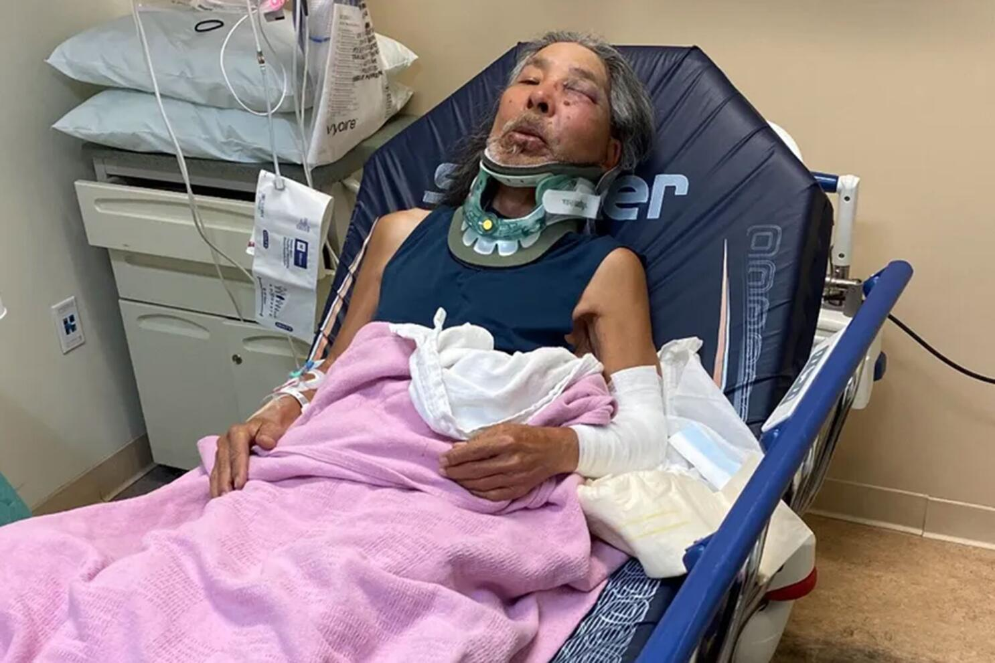
WHY IT MATTERS
At the Stop AAPI Hate reporting center, we received reports of 12,255 anti-AA/PI hate acts occurring from 2020-2023, with 735 occurring in 2023…Nearly half (49%) of AA/PI adults surveyed experienced a hate act in 2023. This means that millions of AA/PI people are likely to have experienced a hate act in the last year and that anti-AA/PI hate is a pervasive and systemic issue. (Stop Asian Hate)
Since the election, anti-Asian slurs have dramatically increased by 66% and, amongst Asian American subgroups, South Asians communities have been most targeted, with 75% of slurs directed at them in December 2024 and January 2025.
60% of Asian American, Native Hawaiian and Pacific Islander (AAPI) adults have little or no confidence that the government will make progress on key issues in 2025—a slightly less pessimistic outlook compared with the 69% who felt this way last year. (AAPI Data)

Slide 5
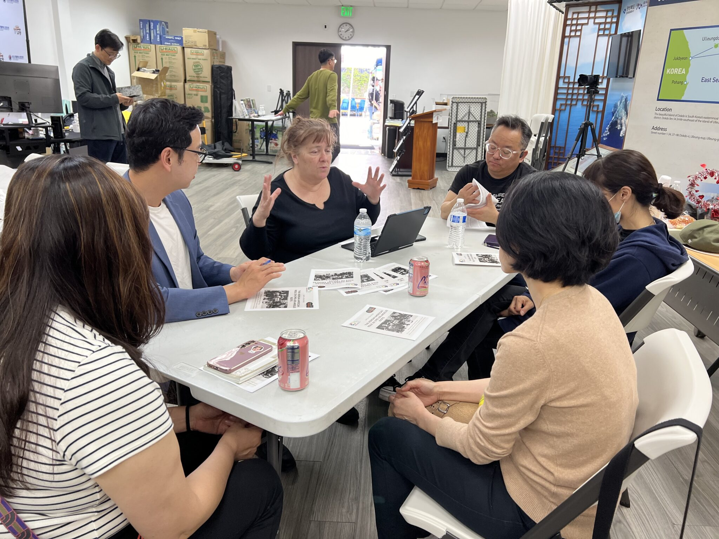
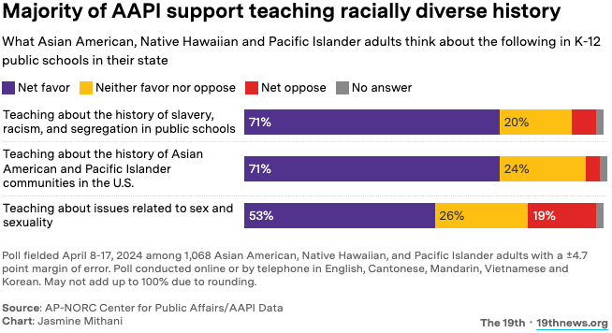

THE POWER OF TELLING OUR STORIES
AAPI narratives have often been shaped by outsiders, but reclamation is a form of resistance
According to TAAF’s annual Social Tracking of Asian Americans in the U.S. Index, the leading study on perceptions and attitudes towards the AAPI community, 55% of Americans are unable to name a single historical event related to Asian Americans.
58% of Asian Americans say they rarely or never see people like them in media (Pew Research, 2022)
2 in 3 AAPI adults report feeling unseen in national policy conversations (AAPI Data, 2024)

Slide 6
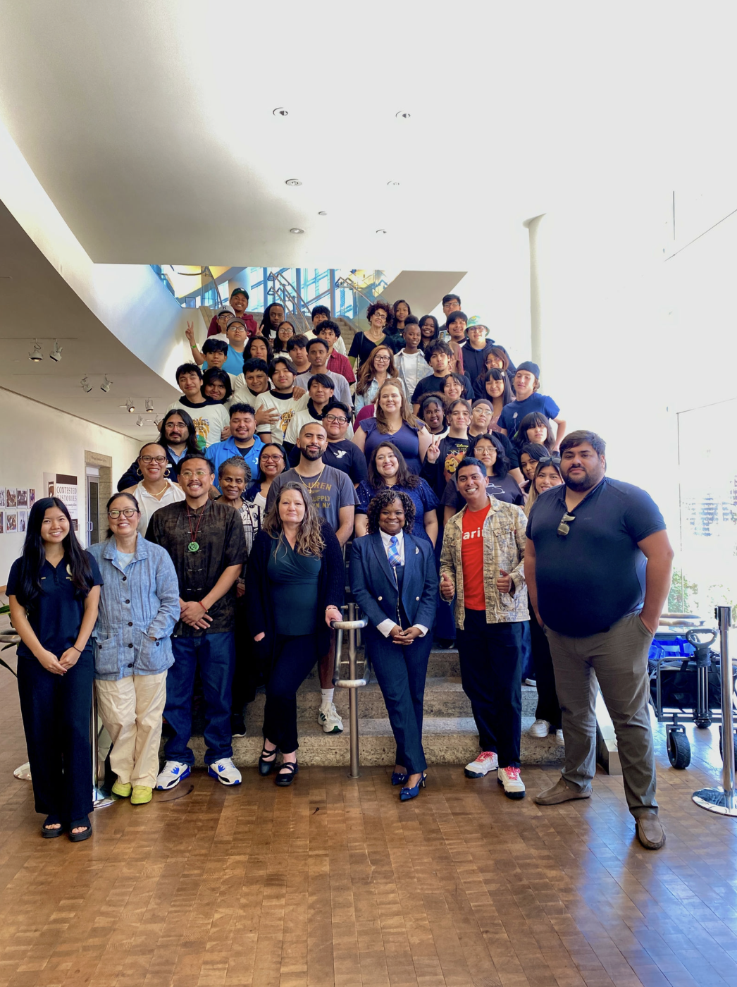
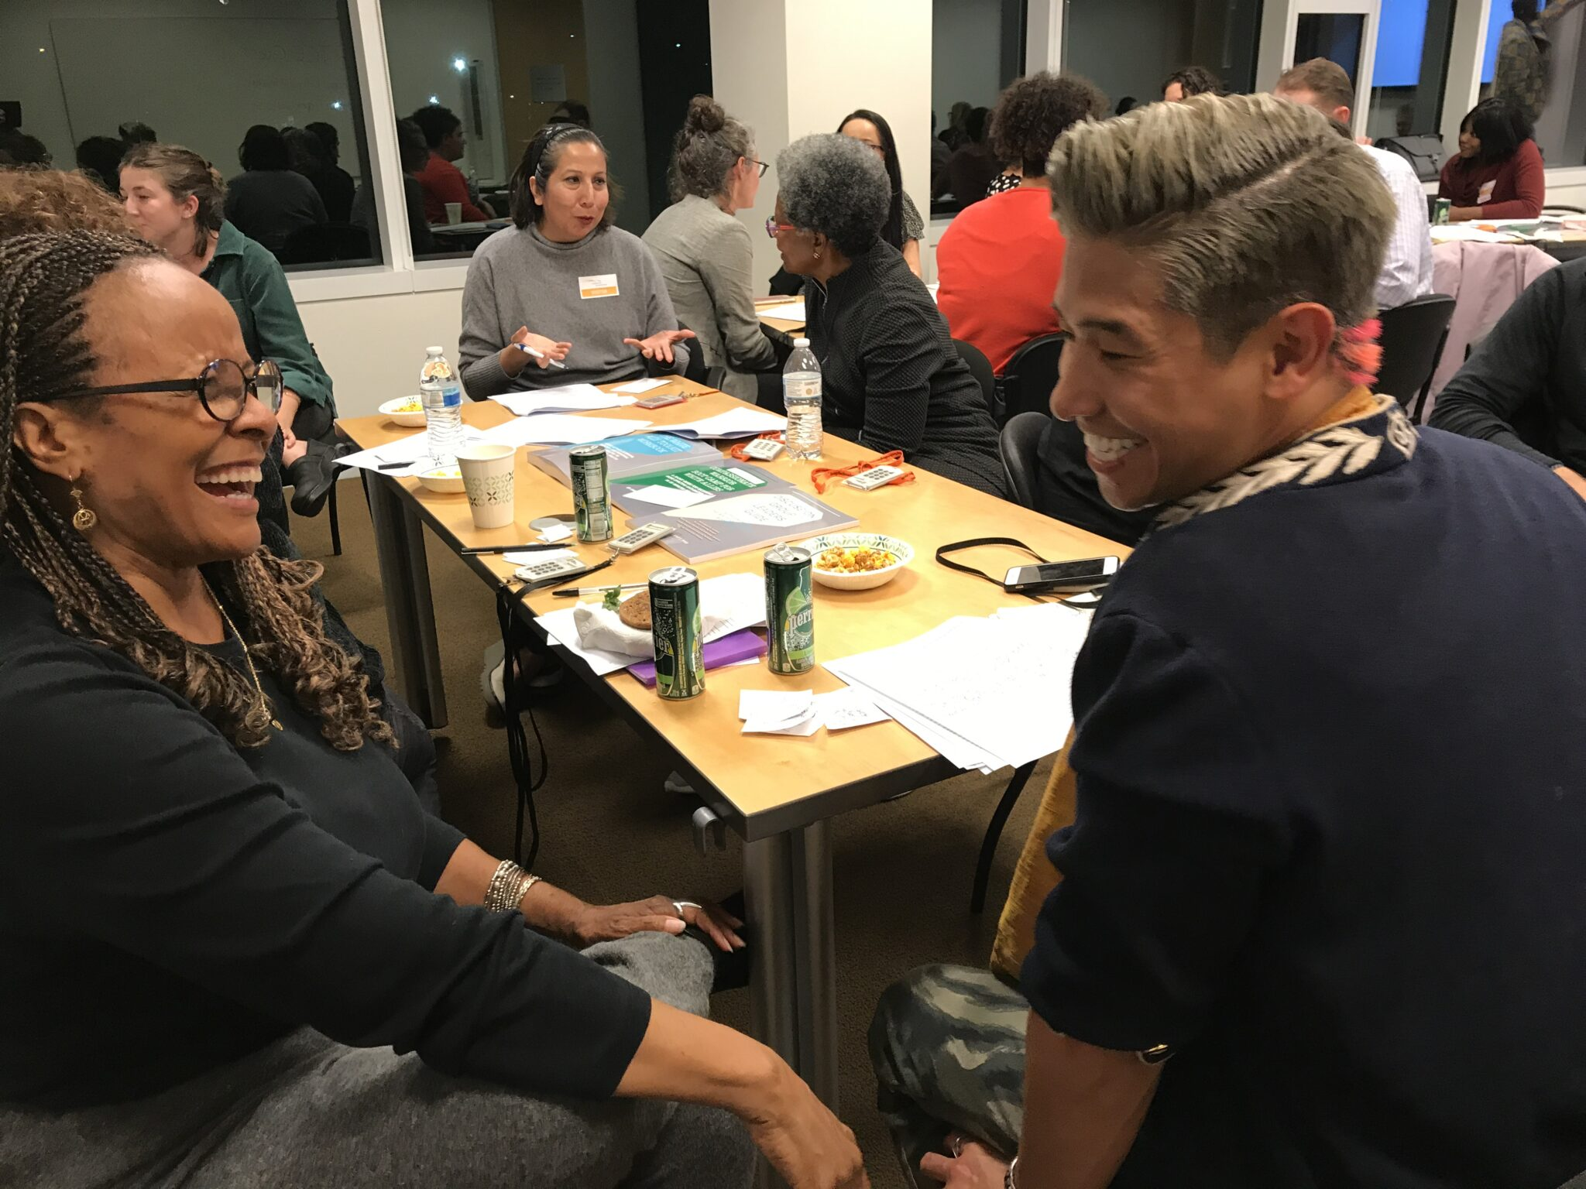
WHY DIALOGUE
Fosters Understanding: Dialogue creates a space for individuals to exchange thoughts, ideas, and emotions, facilitating the exchange of perspectives and building relationships.
Promotes Civic Engagement: By facilitating respectful, purposeful conversations on public issues and policies, dialogue encourages people to improve their quality of life through civic engagement.
Addresses Complex Issues: Dialogues have been conducted on topics such as racism, gun violence, policing, and homelessness, demonstrating their effectiveness in tackling sensitive social issues.
Empowers Communities: Initiatives like the CD10 Women in Transition Demonstration Program show how dialogue can support vulnerable populations by building confidence and esteem to aid their transition into permanent housing.
75% of AAPI adults report feeling misunderstood or invisible in national conversations (Pew Research, 2023).

Slide 7
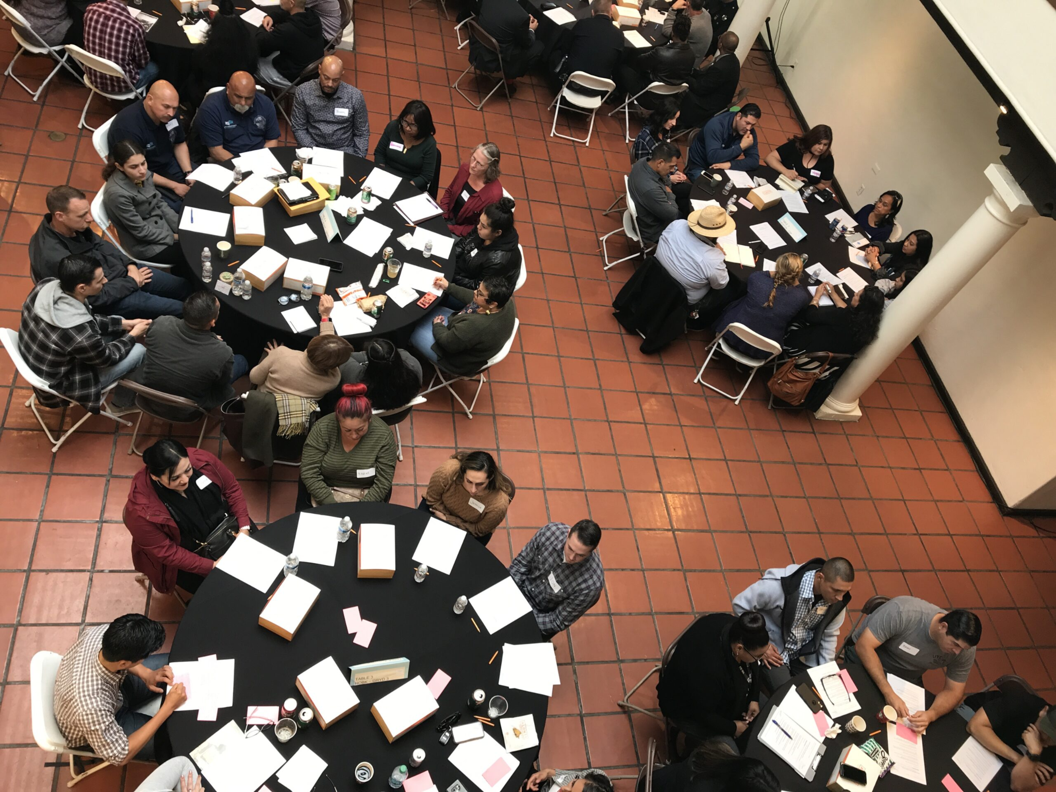
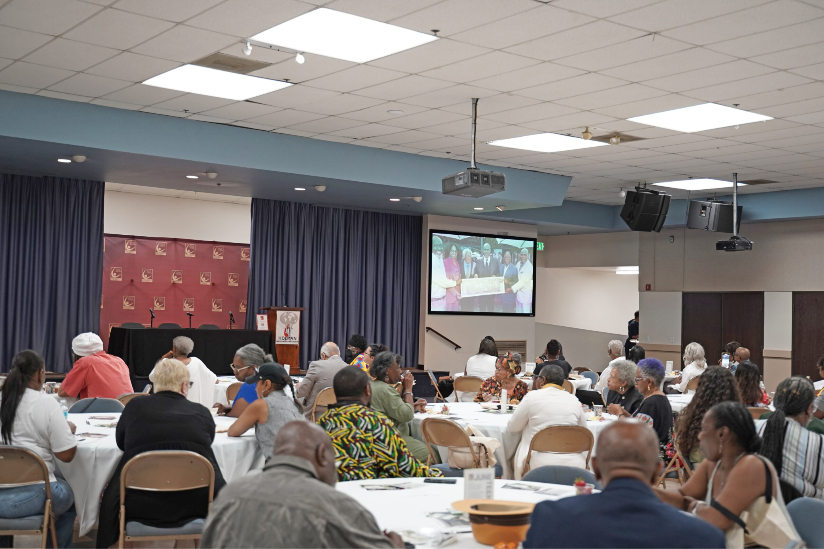
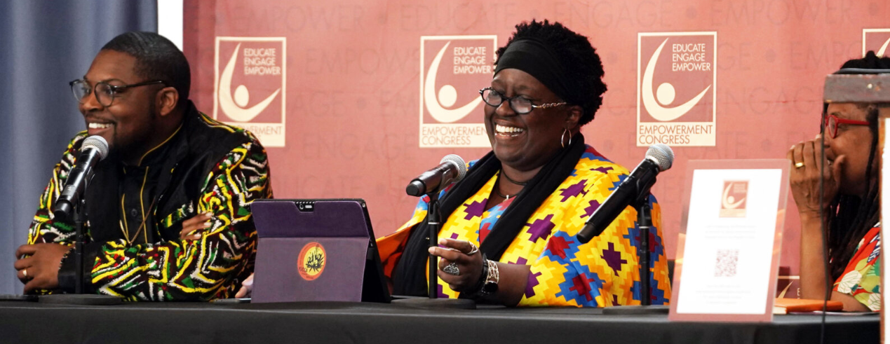
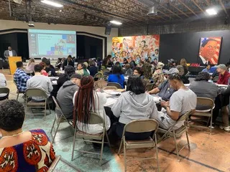
THANK YOU
LET’S GET TO IT!

